Slide 1
Parallel and Distributed Computing in R
Kanak Choudhury

Slide 2
MapReduce Technique
MapReduce originally referred to the proprietary Google technology
A popular open-source implementation is Apache Hadoop
A MapReduce program is composed of a Map() procedure that performs on each part of data and a Reduce() method that performs a summary operation

Slide 3
MapReduce Technique
"Map" step: "map()" function applies to each part of data by each worker node.
"Shuffle" step: Output obtained by “map()” function redistribute such that all data with same key is located on the same worker node.
"Reduce" step: Worker nodes now process each group of output data, per key, in parallel.

Slide 4
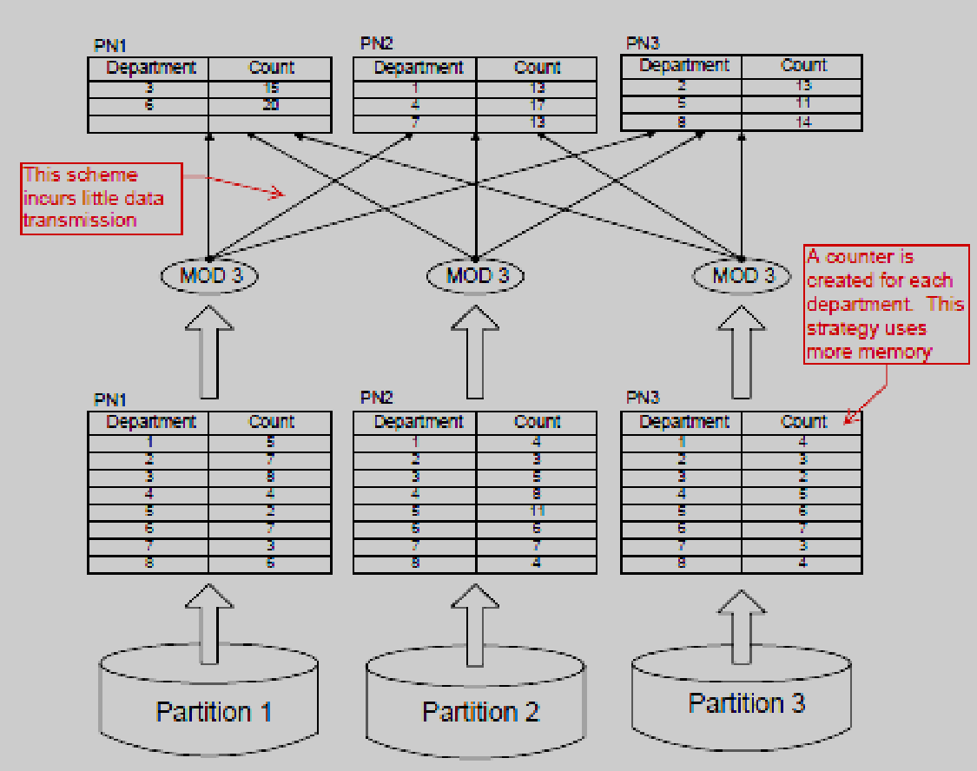
Example: MapReduce

Slide 5
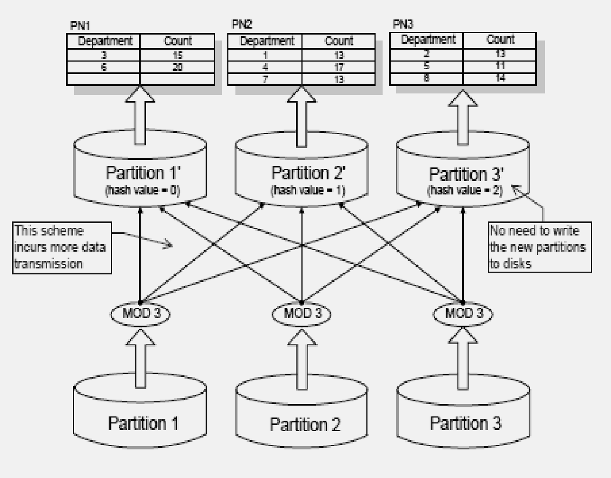
Example: MapReduce

Slide 6
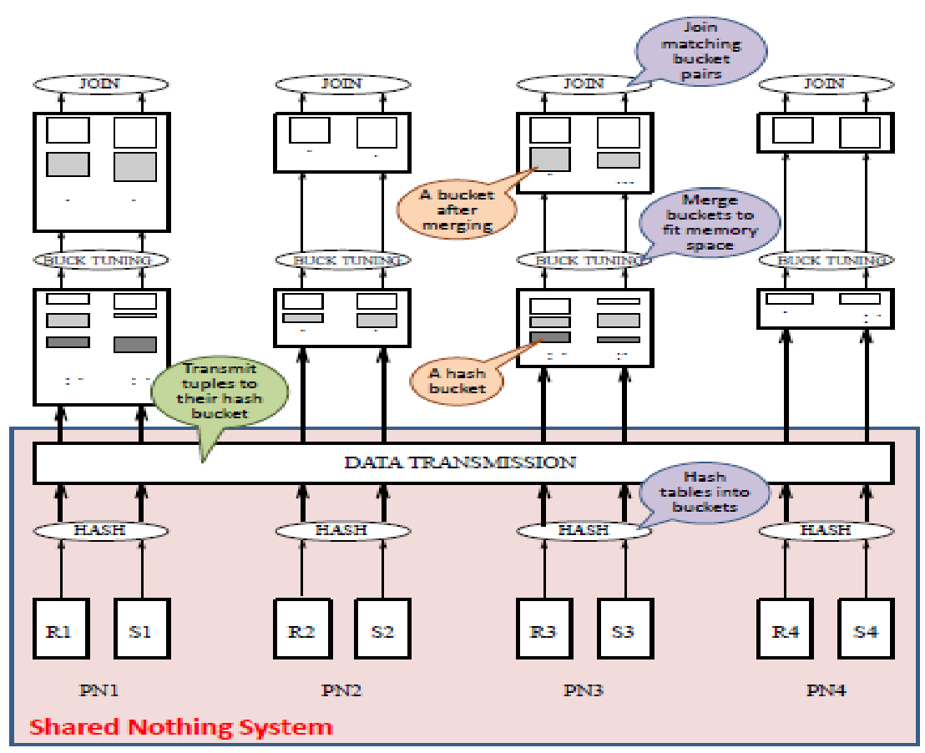
Parallel Computing
Divide large problems into smaller ones, solve independently (many at the same time) and results are combined afterwards

Slide 7
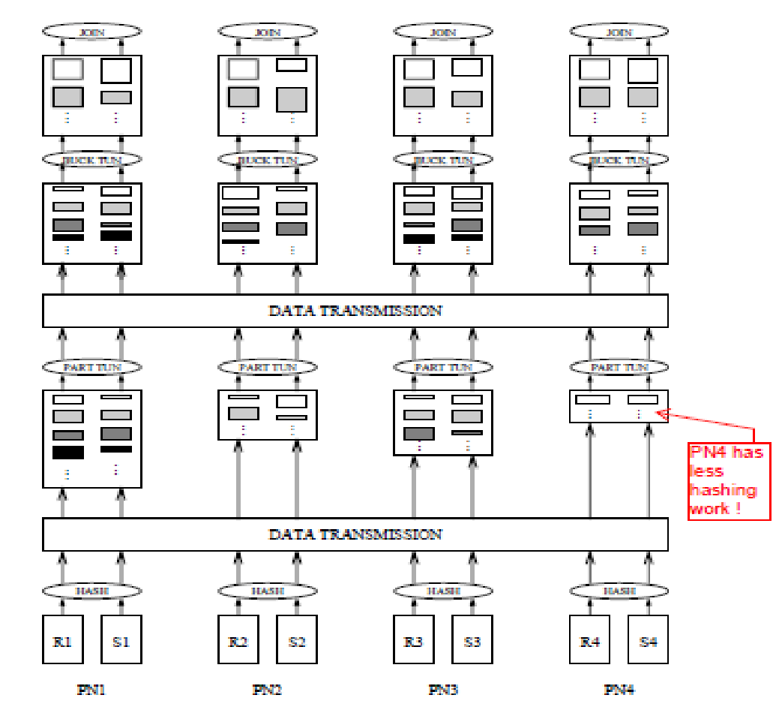
Parallel Computing (Load Balancing)

Slide 8
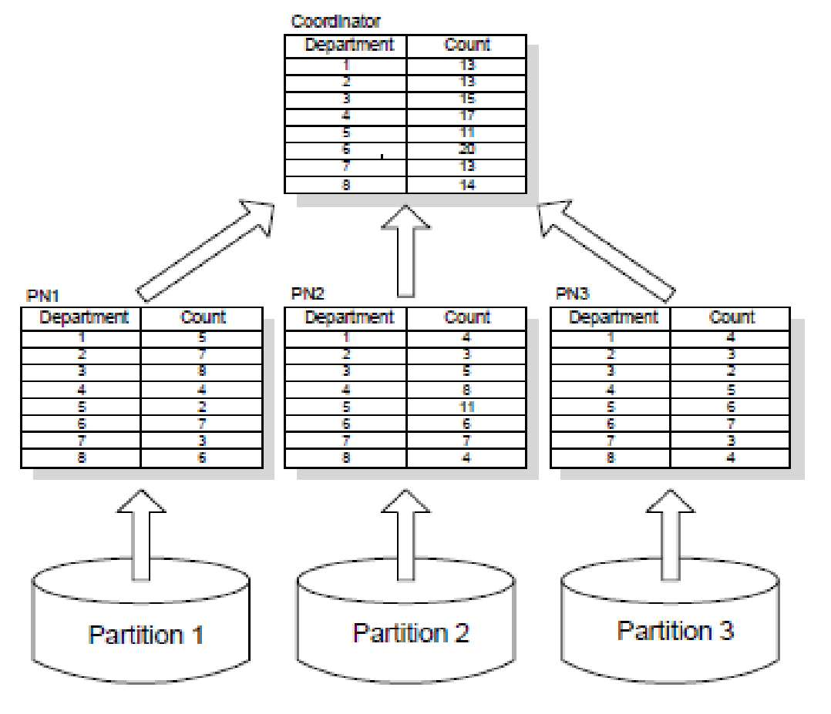
Example: Parallel Computing

Slide 9
Parallel Computing in R
https://cran.r-project.org/web/views/HighPerformanceComputing.html
R Packages
Parallel (SOCK (Socket) concept)
doParallel
Snow
doRedis (MPI (message passing interface) concept) (need to setup redis server)
https://github.com/MicrosoftArchive/redis/releases
Rmpi
doMPI
plyr (it uses the parallelization concept)

Slide 10
Parallel Functions
clusterCall
clusterApply
clusterApplyLB
clusterEvalQ
clusterExport
clusterMap
clusterSplit
parLapply
parSapply
parApply
parRapply
parCapply
parLapplyLB
parSapplyLB

Slide 11
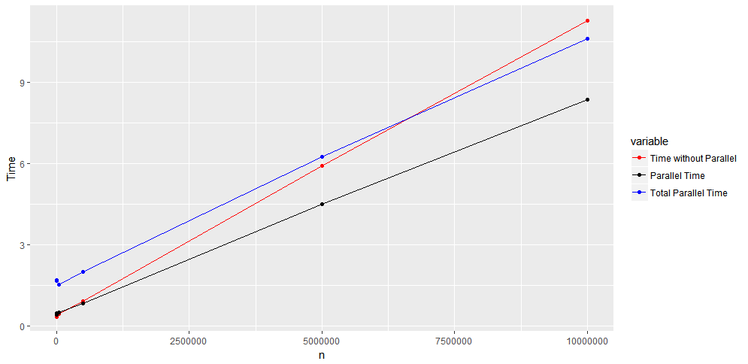
Parallel Computing Time

Slide 12
R Package for GPU
gpuR
cudaBayesreg
Rgpu (speed up bioinformatics analysis by using GPU) https://trac.nbic.nl/index/
RPUD
RPUDPLUS
RPUSVM
Accelerate R Applications with CUDA (Compute Unified Device Architecture) https://devblogs.nvidia.com/accelerate-r-applications-cuda/

Slide 13
Parallel Computing: Hadoop
RHIPE (http://deltarho.org/docs-RHIPE/#the-r-session-server-and-rstudio)
https://www.dezyre.com/article/r-hadoop-a-perfect-match-for-big-data/292
rMR
RProtoBuf

Slide 14
Machine Learning Packages
caret
h2o (computes parallel distributed machine learning algorithms)
GLM, GBM, RF and NN within various cluster environments
parallelSVM
ParallelForest
e1071

Slide 15
Reference
https://en.wikipedia.org/wiki/MapReduce
http://www.cs.ucf.edu/~kienhua/classes/
https://cran.r-project.org/web/views/HighPerformanceComputing.html
https://github.com/MicrosoftArchive/redis/releases
https://trac.nbic.nl/index/
http://deltarho.org/docs-RHIPE/#the-r-session-server-and-rstudio
https://www.dezyre.com/article/r-hadoop-a-perfect-match-for-big-data/292

Slide 16
Thank you!

